Slide 1

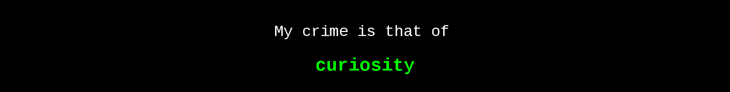
Hacking-Lab
Practice Reviews

Slide 2
Hacking-Lab Practice Review
A2 Wireshark gc.php c2 Q 4
Go to A2 Wireshark gc.php c2 traffic
Under Resources, download the zip file containing the recording.pcap and apache.pem files. Open the pcap file using Wireshark.
What is the serial number in the command being sent to the C2 server? (you will need to do some decoding)
Explanation:

Slide 3
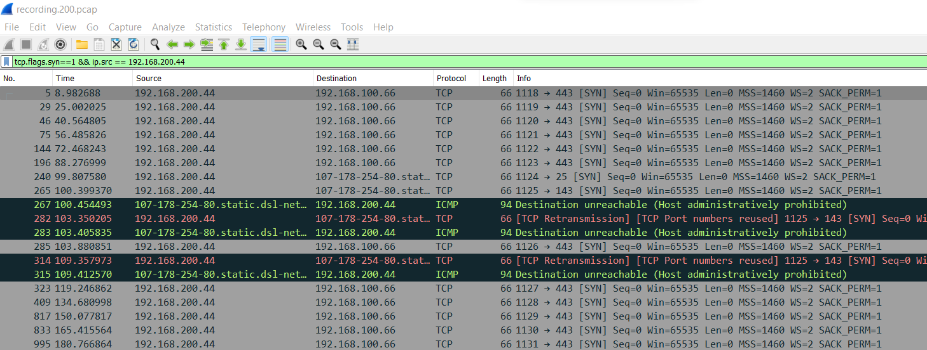
Hacking-Lab Practice Review
A2 Wireshark gc.php c2 Q 4
Step 1: Find the suspicious outgoing traffic that triggers almost every 15 sec.
Since every initial connections require a 3-way handshake, filter the pcap by the SYN flag.
You will see many connections made. You will notice 192.168.200.44 is of interest, because it is making many outgoing connections.
In particular, you notice that it made many outgoing connections to 192.168.100.66.
By looking at the Time column, you can sense that a connection is almost made every 15 sec.
Time
Source & Destination
This is just other random traffic for you to filter out
Syn

Slide 4
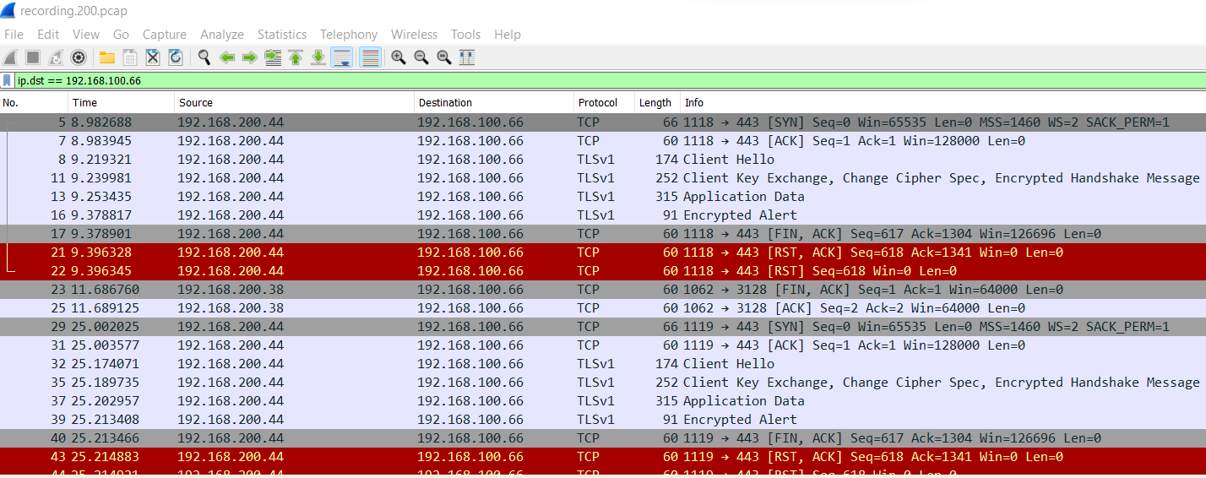
Hacking-Lab Practice Review
A2 Wireshark gc.php c2 Q 4
Step 2: Now, you know that destination 192.168.100.66 is likely a C2 server.
Filter the pcap by the 192.168.100.66.
You will notice the communication is encrypted using TLS. is of interest, because it is making many outgoing connections.
You notice that there is Application Data. This is of concern.
Let’s narrow only to packet 5 – 22, where there is a complete transaction. The rest are just being repeated every 15 sec.

Slide 5
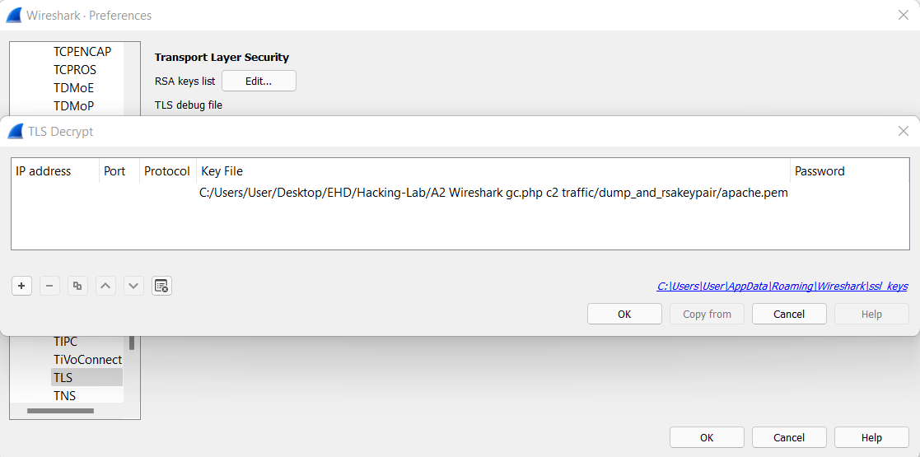
Hacking-Lab Practice Review
A2 Wireshark gc.php c2 Q 4
Step 3: Now you know that the communication is encrypted and that there is application data involved, use the given key to decrypt to see what’s in there.

Slide 6
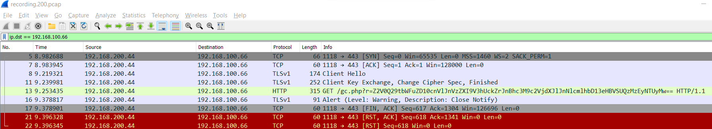
Hacking-Lab Practice Review
A2 Wireshark gc.php c2 Q 4
Step 4: Now that the communication is decrypted, you notice that the Application Data in packet 13 is now in clear-text.
You notice that the client 192.168.200.44 is getting some data via PHP from the C2 server 192.168.100.66. However, it seems that the data is encoded by a random string.
Since Base64 is the easiest to decode, let’s copy the random string and decode using an online decoder.
Random String (is between the =):
Z2V0Q29tbWFuZD10cnVlJnVzZXI9V3hUckZrJnBhc3M9c2VjdXJlJnNlcmlhbD13eHBVSUQzMzEyNTUyMw

Slide 7
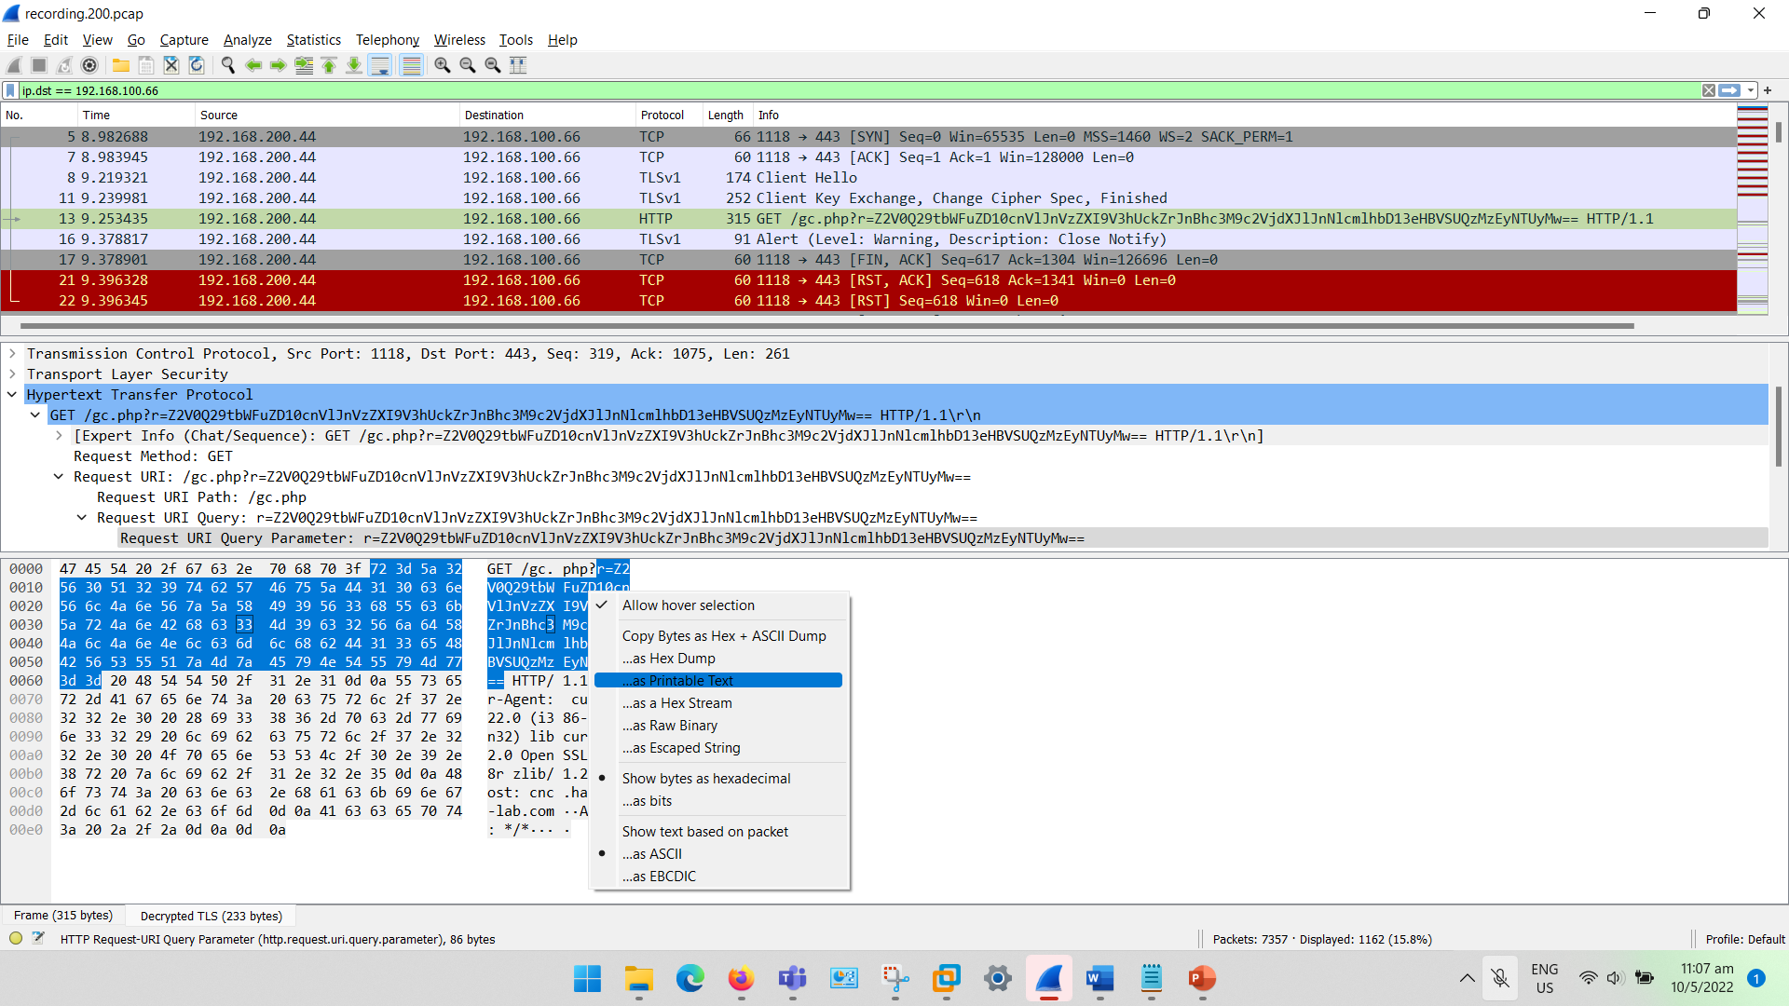
Hacking-Lab Practice Review
A2 Wireshark gc.php c2 Q 4
Step 5: Copy the random string as “Printable Text”.
You will need to remove anything before the “==“ and after the “=“
Random String:
GET /gc.php?r=Z2V0Q29tbWFuZD10cnVlJnVzZXI9V3hUckZrJnBhc3M9c2VjdXJlJnNlcmlhbD13eHBVSUQzMzEyNTUyMw== HTTP/1.1 User-Agent: curl/7.22.0 (i386-pc-win32) libcurl/7.22.0 OpenSSL/0.9.8r zlib/1.2.5 Host: cnc.hacking-lab.com
Accept: */*

Slide 8
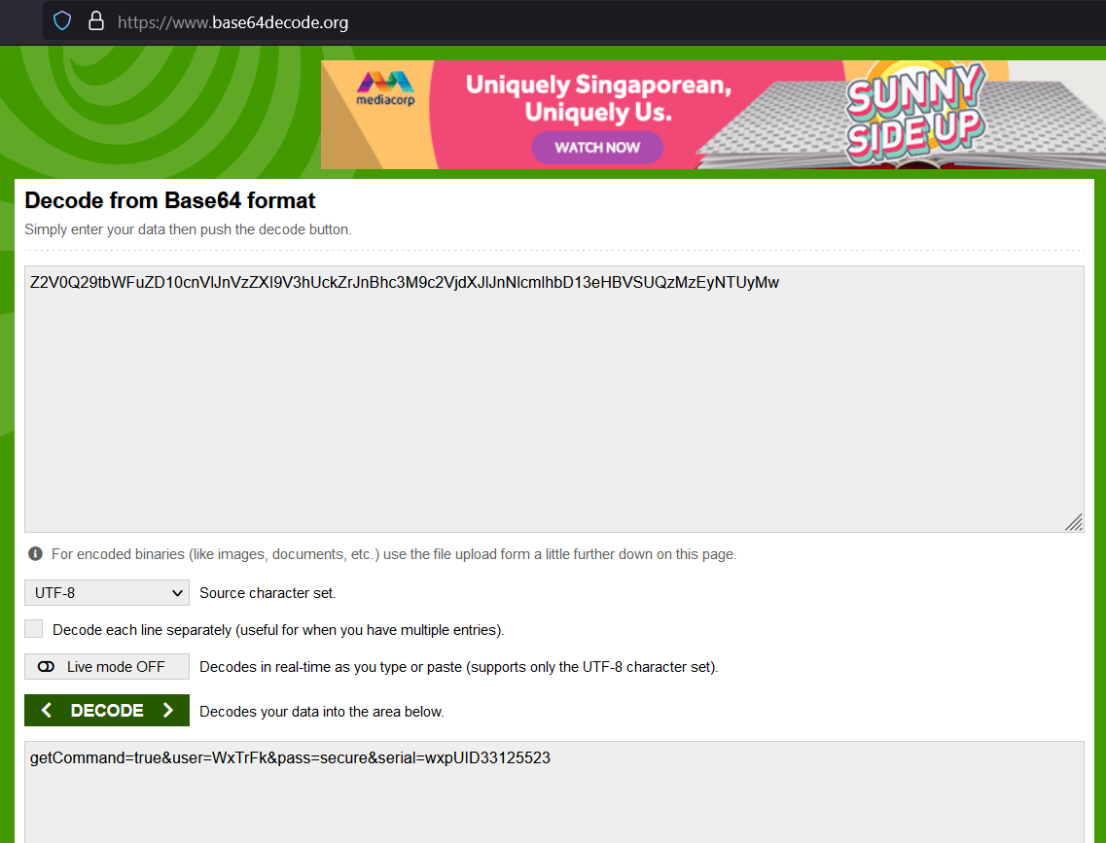
Hacking-Lab Practice Review
A2 Wireshark gc.php c2 Q 4
Step 6: Search for an online Base64 decoder. This is just one of the many online decoders.
https://www.base64decode.org/
Paste the random string into the decoder and you get the next layer of information! The serial number!
getCommand=true&user=WxTrFk&pass=secure&serial=wxpUID33125523

Slide 9


